Slide 1


Learn Python in Two Months

Slide 2
How is our Journey goes on
Course Structure [Python + Pandas + Django + REST + SQL]
Recent Interview Question Discussions
Git Concepts + Work parallelly by creating branches on repo
Jira Environment for developer
Debugging Concepts
Some Funny ad Tricky question discussions during class
How to apply learning concepts on Real time
How to use Stack Overflow +Google

Slide 3
Why Python
https://www.futurelearn.com/info/blog/what-is-python-used-for
Web development
Programming applications
AI and machine learning
Data analytics
Data visualisation
Game development
SEO (Search Engine Optimization)
Design

Slide 4
Overview
History
Installing & Running Python
Names & Assignment

Slide 5
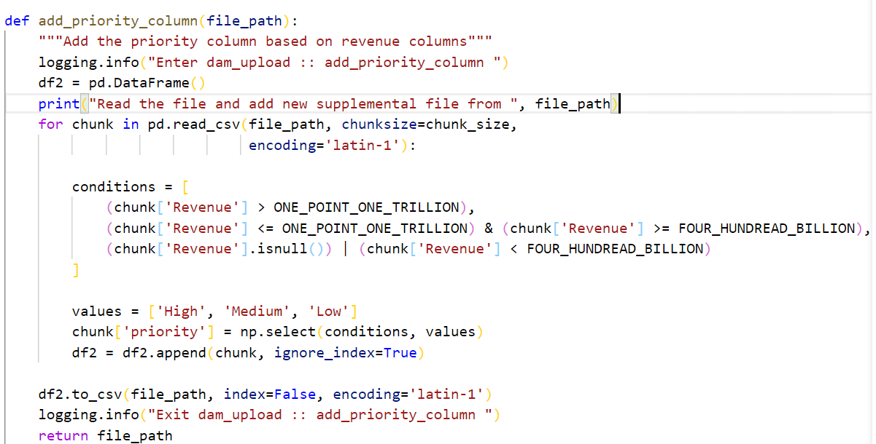


Slide 6
Installing
Download from http://python.org/download/
Python comes with a large library of standard modules
There are several options for an IDE
  IDLE – works well with Windows
  Visual Studio Code
  Pycharm

Slide 7
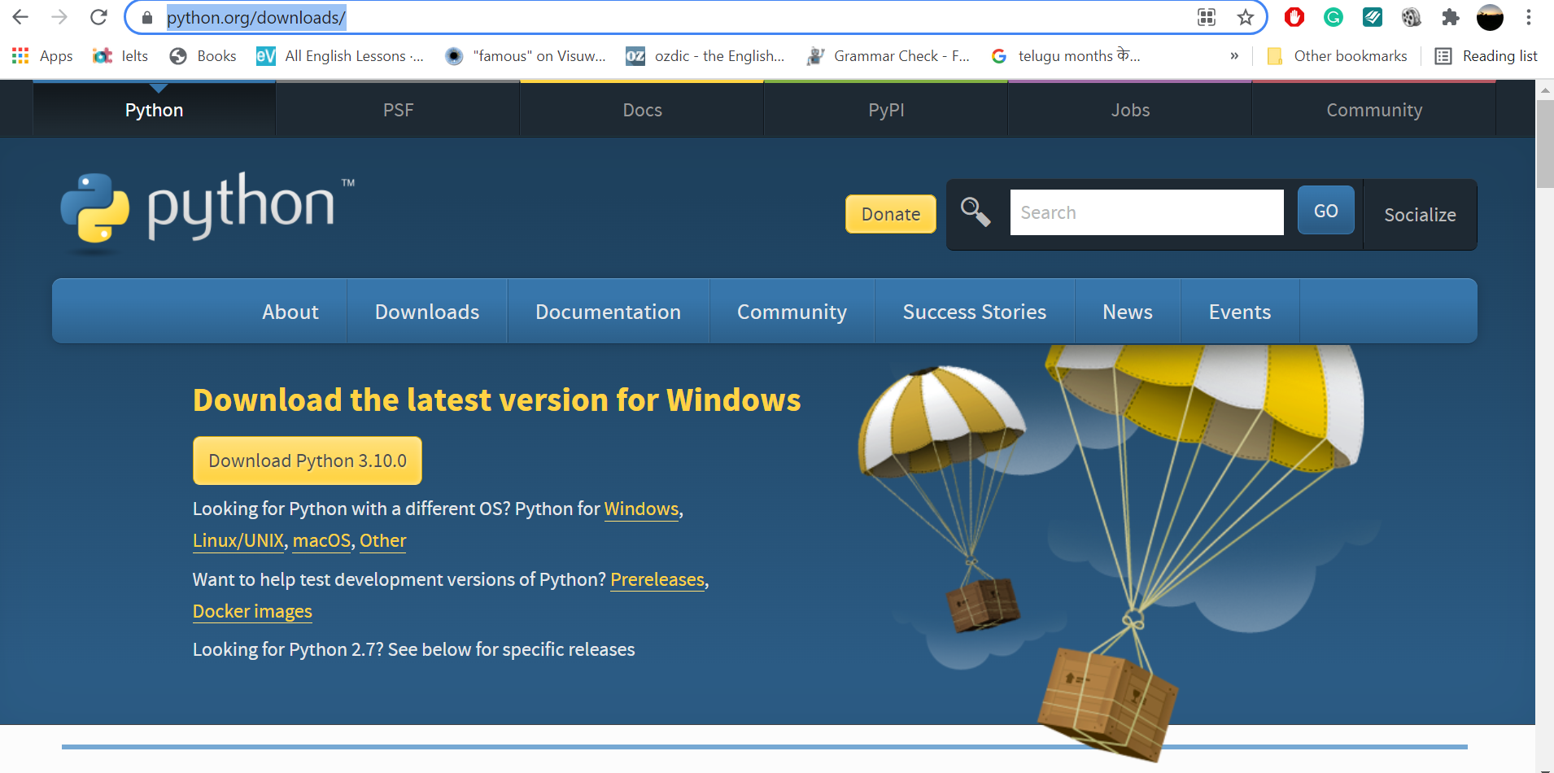

Slide 8
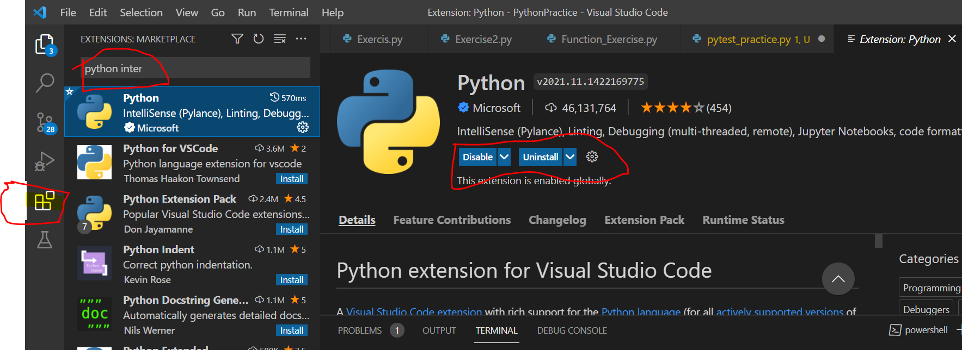
After Installation →Extensions →Search Python → Install Python
extentions needs to add to vs code:
Theme : one dark pro
prettier code formatter
pylint
flake8
Auto Rename Tag

Slide 9
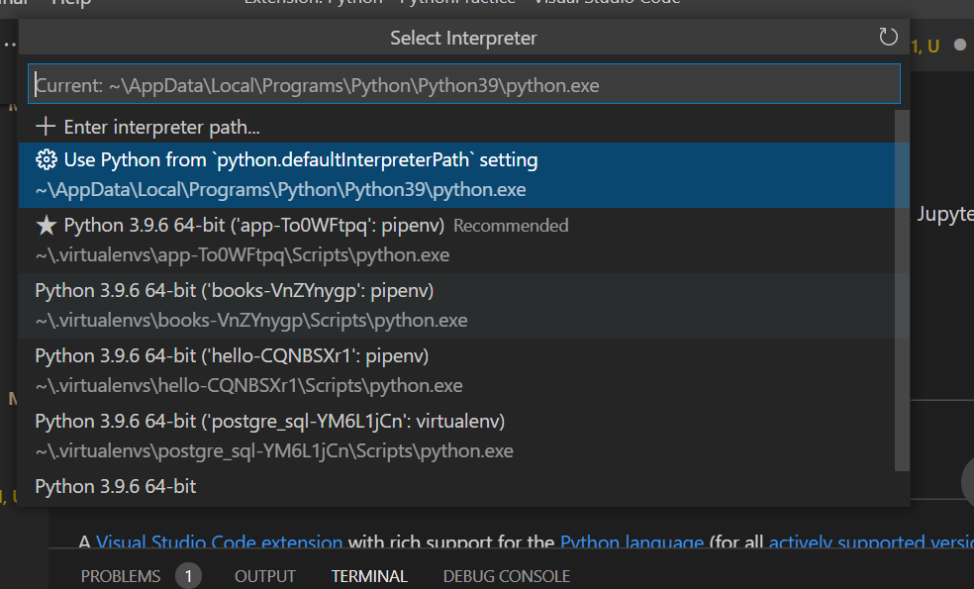
Ctrl + Shift +P -→ type (python: Select Interpreter) →Click and Select Python Environment

Slide 10
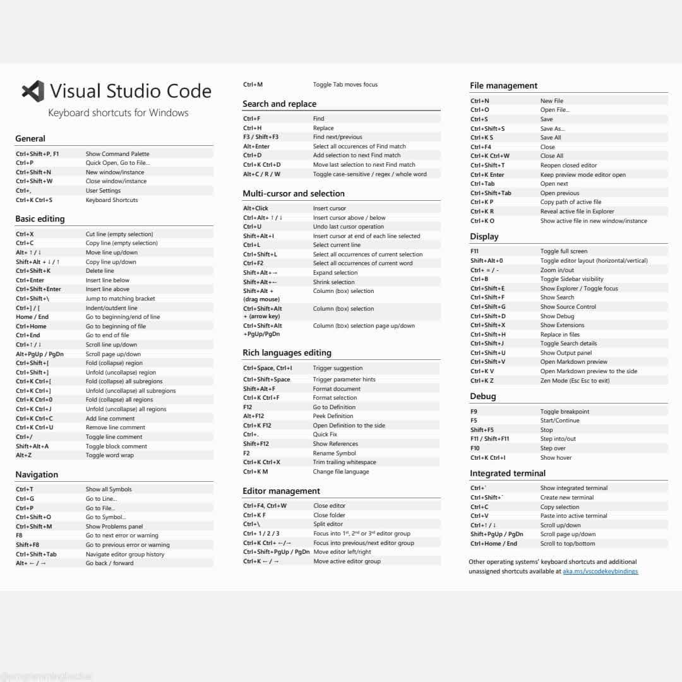

Slide 11
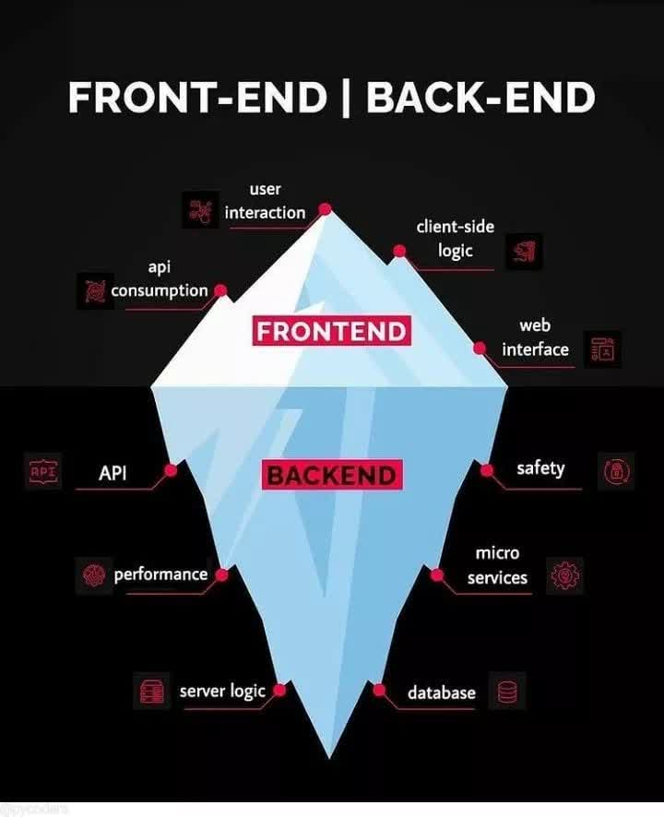

Slide 12
Python Features
Dynamically Typed Language (No need to define int, float or etc..)
Large Standard Library (large standard library which provides a rich set of module and functions so you do not have to write your own code for every single thing, math, regular expression, unit_testing, Django..like)
Interpreted Language
Extensible feature: We can write us some Python code into C or C++ language and also we can compile that code in C/C++ language.
Object-Oriented Language:
Free and Open Source:
Easy to code (Indentation, no semicolon, no brackets)

Slide 13
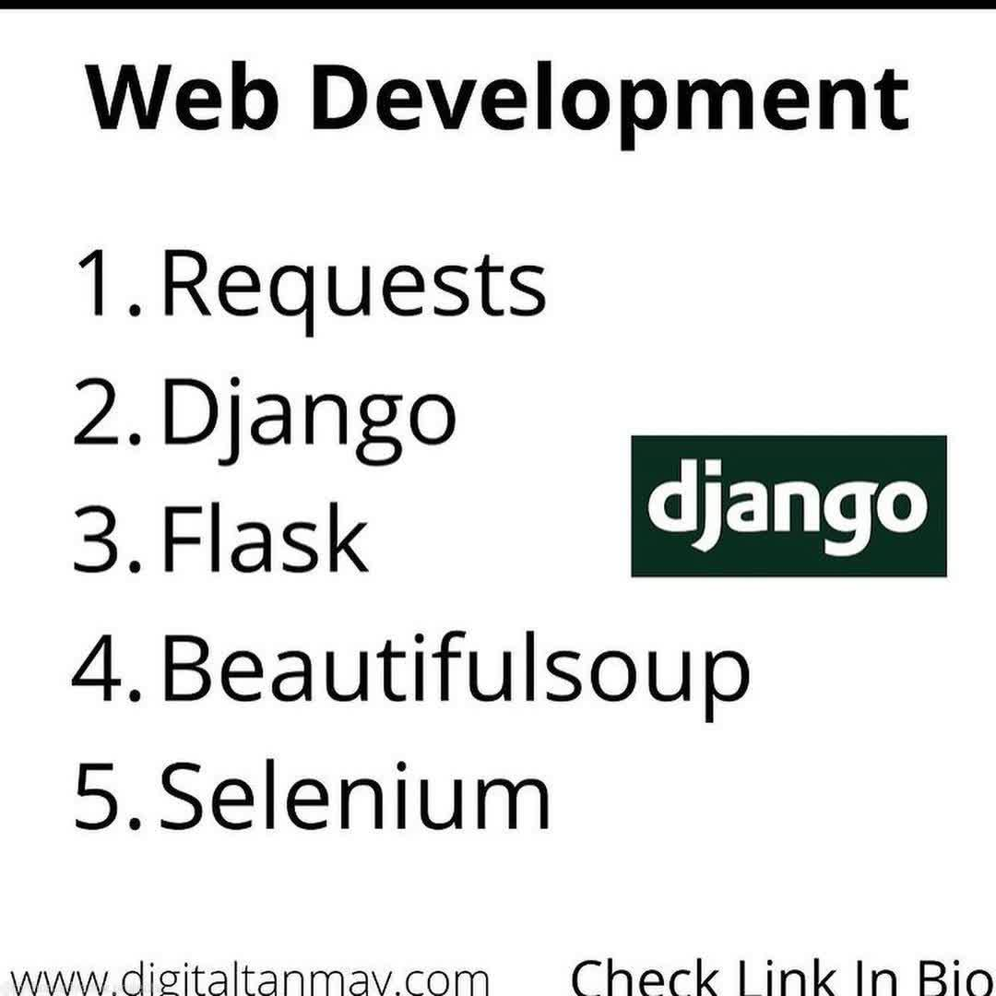
Important Modules

Slide 14
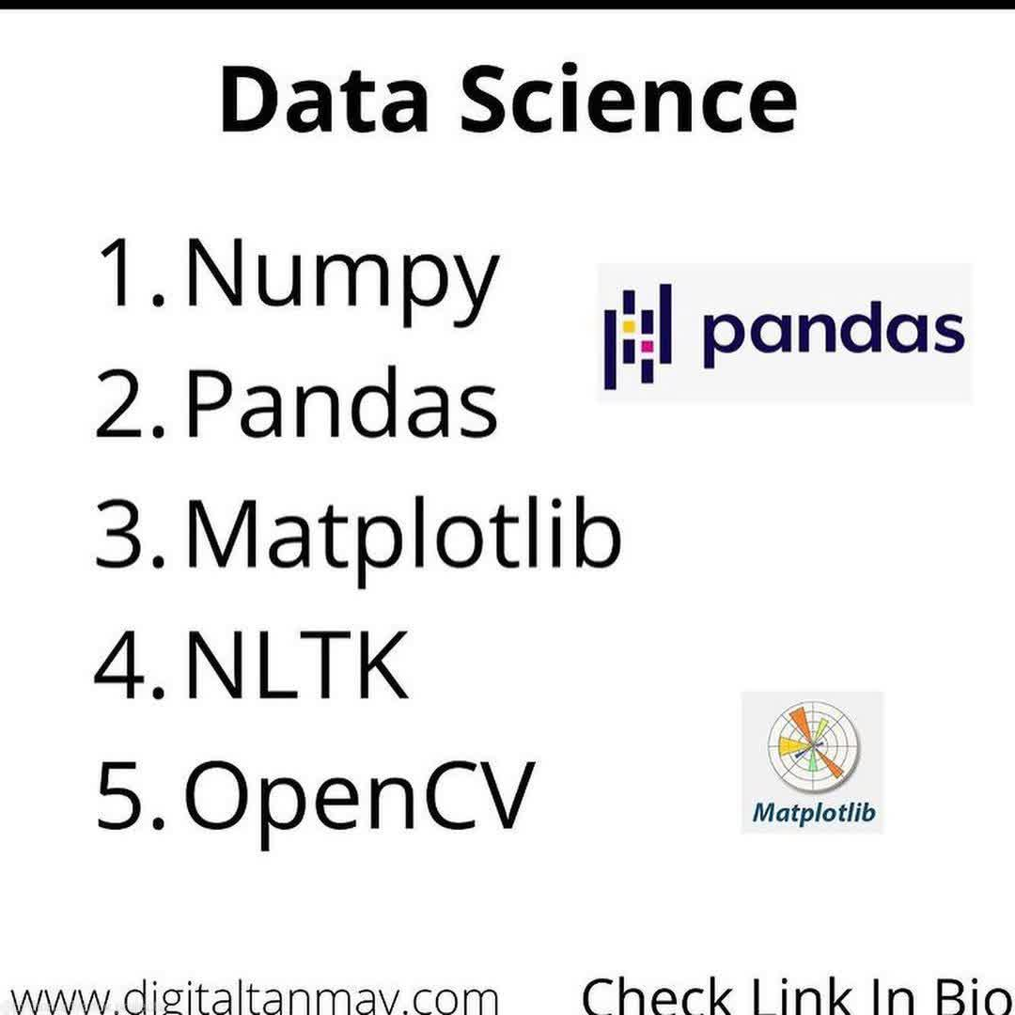
Important Modules

Slide 15
Functional Programming | Object Oriented Programming
This programming paradigm emphasizes on the use of functions where each function performs a specific task. | This programming paradigm is based on object-oriented concept. Classes are used where instance of objects are created
Fundamental elements used are variables and functions.The data in the functions are immutable(cannot be changed after creation). | Fundamental elements used are objects and methods and the data used here are mutable data.

Slide 16

Running Python

Slide 17
The Python Interpreter
Typical Python implementations offer
both an interpreter and compiler
Computer programs are usually written on high level languages. ... Interpreter translates just one statement of the program at a time into machine code. Compiler scans the entire program and translates the whole of it into machine code at once.

Slide 18
A Code Sample (in IDLE)
x = 34 - 23 # A comment.
y = “Hello” # Another one.
z = 3.45
if z == 3.45 or y == “Hello”:
x = x + 1
y = y + “ World” # String concat.
print x
print y

Slide 19
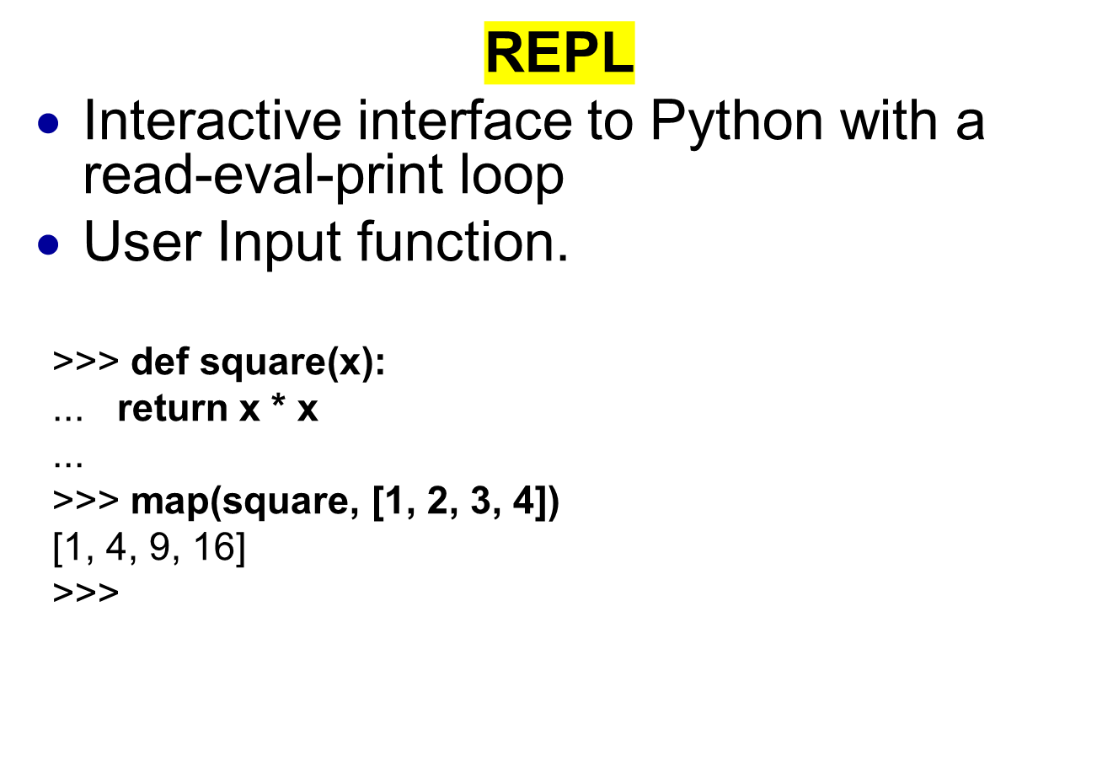

Slide 20
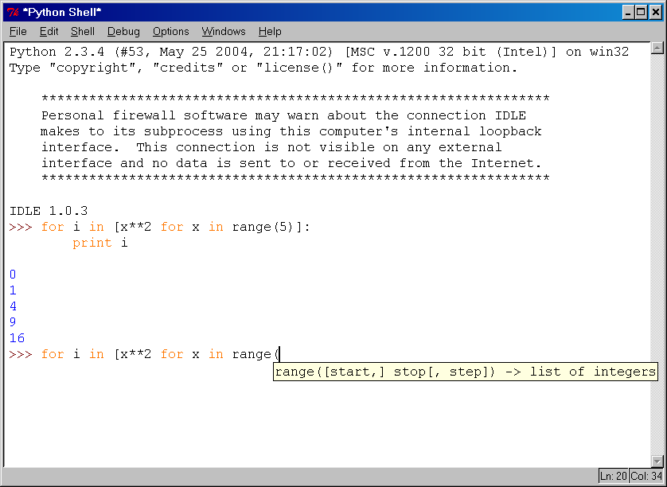
IDLE Development Environment
IDLE is an Integrated DeveLopment Environ-ment for Python, typically used on Windows
Multi-window text editor with syntax highlighting, auto-completion, smart indent and other.
Python shell with syntax highlighting.
Integrated debugger
with stepping, persis-
tent breakpoints,
and call stack visi-
bility

Slide 21
Example ‘script’: fact.py
#! /usr/bin/python
def fact(x):
"""Returns the factorial of its argument, assumed to be a posint"""
if x == 0:
return 1
return x * fact(x - 1)
print
print ’N fact(N)’
print "---------"
for n in range(10):
print n, fact(n)

Slide 22
Python Scripts
When you call a python program from the command line the interpreter evaluates each expression in the file
Familiar mechanisms are used to provide command line arguments and/or redirect input and output
Python also has mechanisms to allow a python program to act both as a script and as a module to be imported and used by another python program

Slide 23
Example of a Script
#! /usr/bin/python
""" reads text from standard input and outputs any email
addresses it finds, one to a line.
"""
import re
from sys import stdin
# a regular expression ~ for a valid email address
pat = re.compile(r'[-\w][-.\w]*@[-\w][-\w.]+[a-zA-Z]{2,4}')
for line in stdin.readlines():
for address in pat.findall(line):
print address

Slide 24
Simple functions: ex.py
"""factorial done recursively and iteratively"""
def fact1(n):
ans = 1
for i in range(2,n):
ans = ans * n
return ans
def fact2(n):
if n < 1:
return 1
else:
return n * fact2(n - 1)

Slide 25
Simple functions: ex.py
671> python
Python 2.5.2 …
>>> import ex
>>> ex.fact1(6)
1296
>>> ex.fact2(200)
78865786736479050355236321393218507…000000L
>>> ex.fact1
<function fact1 at 0x902470>
>>> fact1
Traceback (most recent call last):
File "<stdin>", line 1, in <module>
NameError: name 'fact1' is not defined
>>>

Slide 26

The Basics

Slide 27
Enough to Understand the Code
Indentation matters to code meaning
  Block structure indicated by indentation
First assignment to a variable creates it
  Variable types don’t need to be declared.
  Python figures out the variable types on its own.
Assignment is = and comparison is ==
For numbers + - * / % are as expected
  Special use of + for string concatenation and % for string formatting (as in C’s printf)
Logical operators are words (and, or, not) not symbols
The basic printing command is print

Slide 28
Basic Datatypes
Integers (default for numbers)
  z = 5 / 2 # Answer 2, integer division
Floats
  x = 3.456
Strings
  Can use “” or ‘’ to specify with “abc” == ‘abc’
  Unmatched can occur within the string: “matt’s”
  Use triple double-quotes for multi-line strings or strings than contain both ‘ and “ inside of them:
  “““a‘b“c”””

Slide 29
Whitespace
Whitespace is meaningful in Python: especially indentation and placement of newlines
Use a newline to end a line of code
    Use \ when must go to next line prematurely
No braces {} to mark blocks of code, use consistent indentation instead
    First line with less indentation is outside of the block
    First line with more indentation starts a nested block
Colons start of a new block in many constructs, e.g. function definitions, then clauses

Slide 30
Comments
Start comments with #, rest of line is ignored
Can include a “documentation string” as the first line of a new function or class you define
Development environments, debugger, and other tools use it: it’s good style to include one
  def fact(n):
  “““fact(n) assumes n is a positive integer and returns facorial of n.”””
  assert(n>0)
  return 1 if n==1 else n*fact(n-1)

Slide 31
Assignment
Binding a variable in Python means setting a name to hold a reference to some object
  Assignment creates references, not copies
Names in Python do not have an intrinsic type, objects have types
  Python determines the type of the reference automatically based on what data is assigned to it
You create a name the first time it appears on the left side of an assignment expression:
x = 3
A reference is deleted via garbage collection after any names bound to it have passed out of scope
Python uses reference semantics (more later)

Slide 33
Naming Rules
Names are case sensitive and cannot start with a number. They can contain letters, numbers, and underscores.
  bob Bob _bob _2_bob_ bob_2 BoB
There are some reserved words:
  and, assert, break, class, continue, def, del, elif, else, except, exec, finally, for, from, global, if, import, in, is, lambda, not, or, pass, print, raise, return, try, while

Slide 34
Naming conventions
The Python community has these recommend-ed naming conventions
joined_lower for functions, methods and, attributes
joined_lower or ALL_CAPS for constants
StudlyCaps for classes
camelCase only to conform to pre-existing conventions
Attributes: interface, _internal, __private

Slide 35
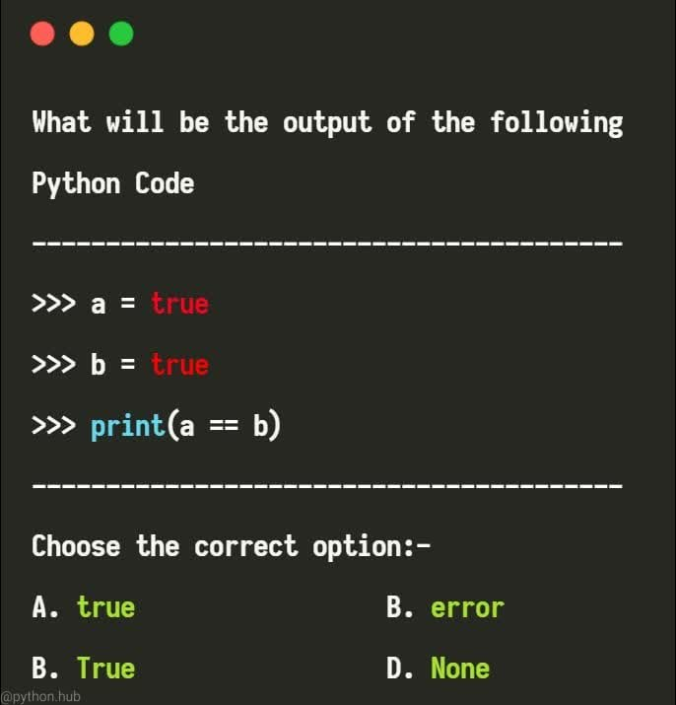
Guess it?

Slide 36
Assignment
You can assign to multiple names at the same time
  >>> x, y = 2, 3
  >>> x
  2
  >>> y
  3
This makes it easy to swap values
  >>> x, y = y, x
Assignments can be chained
  >>> a = b = x = 2

Slide 37
Accessing Non-Existent Name
Accessing a name before it’s been properly created (by placing it on the left side of an assignment), raises an error
>>> y
Traceback (most recent call last):
File "<pyshell#16>", line 1, in -toplevel-
y
NameError: name ‘y' is not defined
>>> y = 3
>>> y
3

Slide 38
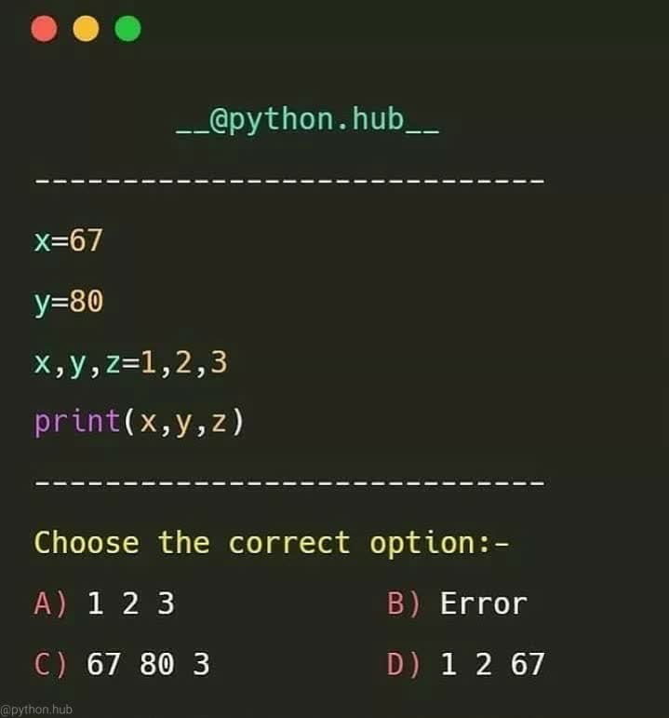
Guess it?

Slide 39
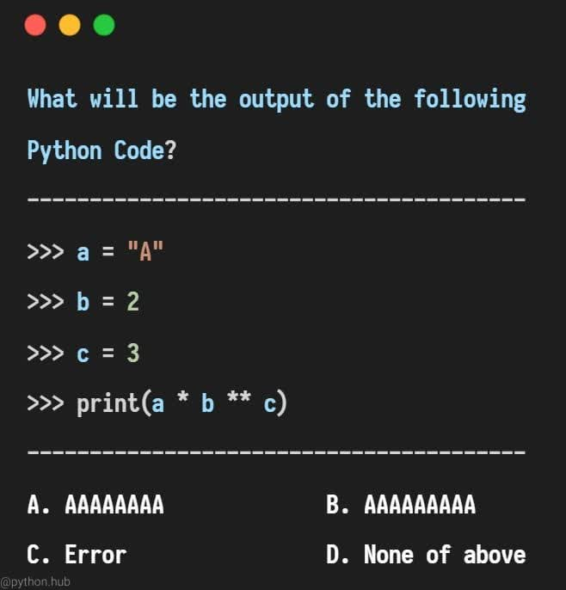
Guess it?

Slide 40
Number Types
int | long | float | complex
10 | 51924361L | 0 | 3.14j
100 | -0x19323L | 15.2 | 45.j
-786 | 0122L | -21.9 | 9.322e-36j
80 | 0xDEFABCECBDAECBFBAEl | 32.3+e18 | .876j
-490 | 535633629843L | -90 | -.6545+0J
-0x260 | -052318172735L | -3.25E+101 | 3e+26J
0x69 | -4721885298529L | 70.2-E12 | 4.53e-7j

Slide 41
Number Type Conversion:
Type int(x)to convert x to a plain integer.
Type long(x) to convert x to a long integer.
Type float(x) to convert x to a floating-point number.
Type complex(x) to convert x to a complex number with real part x and imaginary part zero.
Type complex(x, y) to convert x and y to a complex number with real part x and imaginary part y. x and y are numeric expressions

